Slide 1
Special Course in Software Engineering ‘24
MINI-PROJECT PRESENTATION
GROUP NO. 24: Confusion Matrix

Slide 2
Group Introduction

Slide 3
Project module and module leader
Module Name | Module leaders
Data Inspection and Plotting | Qihao Zhuang, Yifan Li
Analysis and Hypothesis Testing | Bo Zhang, Yifan Li
Sentiment Analysis (NLP) | Yikai Zhang, Yifan Li
Data Cleaning and preprocessing | Yifan Li
Main Module | Yifan Li

Slide 4
Dataset

Slide 5
Dataset introduction
Dataset name:
Heart attack prediction dataset
Brief description:
The Heart Attack Risk Prediction Dataset is a valuable tool for understanding the predictors of heart health and the risk factors associated with heart attacks.
It includes diverse attributes such as age, cholesterol levels, lifestyle choices, and medical history, enabling researchers and healthcare professionals to apply predictive analytics and machine learning for proactive heart disease prevention.
With 8,763 records from patients worldwide, this dataset supports comprehensive analysis and research aimed at improving cardiovascular health outcomes.

Slide 6
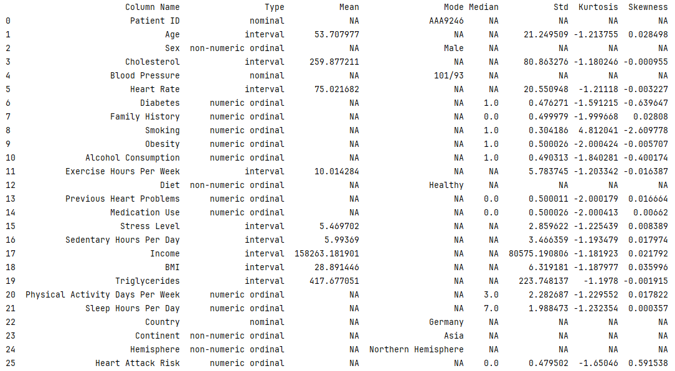

Slide 7
(Variable Name #1) distribution
(
Depending on the type of variable, plot its distribution.
Pick only the variables that you utilize in your analysis.
Describe briefly the results in your own words
Use one slide for each visualization
DO NOT PLOT DISTRIBUTION FOR ALL THE VARIABLES.
)

Slide 8
(Variable Name #2) distribution
(
Depending on the type of variable, plot its distribution.
Pick only the variables that you utilize in your analysis.
Describe briefly the results in your own words
Use one slide for each visualization
DO NOT PLOT DISTRIBUTION FOR ALL THE VARIABLES.
)

Slide 9
(Variable Name #N) distribution
(
Depending on the type of variable, plot its distribution.
Pick only the variables that you utilize in your analysis.
Describe briefly the results in your own words
Use one slide for each visualization
DO NOT PLOT DISTRIBUTION FOR ALL THE VARIABLES.
)

Slide 10
Analysis

Slide 11
Hypothesis #1
(
Depending on the kind of analysis you’ve done, state your first hypotheses as H₀ (Null Hypothesis) and H_{a} (Alternative Hypothesis) here.
Example (Titanic dataset):
H₀ : There is no relationship between gender and the rate of survival
H_{a} : There is a relationship between gender and the rate of survival
)

Slide 12
Testing Hypothesis #1
(
Provide details of the test you used to analyse your data to test your Hypothesis #1.
Use three slides for each hypothesis:
One slide to visualize the test
One slide to describe the results from the test
One slide to state whether you reject or fail to reject the null hypothesis
)

Slide 13
Hypothesis #2
(
Depending on the kind of analysis you’ve done, state your second hypotheses as H₀ (Null Hypothesis) and H_{a} (Alternative Hypothesis) here.
Example (Titanic dataset):
H₀ : There is no difference in the average age of survivors and non-survivors
H_{a} : There is a difference in the average age of survivors and non-survivors
)

Slide 14
Testing Hypothesis #2
(
Provide details of the test you used to analyse your data to test your Hypothesis #2.
Use three slides for each hypothesis:
One slide to visualize the test
One slide to describe the results from the test
One slide to state whether you reject or fail to reject the null hypothesis
)

Slide 15
Hypothesis #N
(
Depending on the kind of analysis you’ve done, state your second hypotheses as H₀ (Null Hypothesis) and H_{a} (Alternative Hypothesis) here.
Example (Titanic dataset):
H₀ : There is no difference in the average age of survivors and non-survivors
H_{a} : There is a difference in the average age of survivors and non-survivors
)

Slide 16
Testing Hypothesis #N
(
Provide details of the test you used to analyse your data to test your Hypothesis #2.
Use three slides for each hypothesis:
One slide to visualize the test
One slide to describe the results from the test
One slide to state whether you reject or fail to reject the null hypothesis
)

Slide 17
(NOT MANDATORY)
Interesting results
BONUS – 5 points

Slide 18
Interesting Hypothesis (NOT MANDATORY)
(
Provide details of any other interesting hypothesis you tested.
Were the results also interesting? Why?
Example (Titanic dataset):
H₀ : There is no relationship between point of embarkation and survival rate
H_{a} : There is a relationship between point of embarkation and survival rate
)

Slide 19
Interesting Hypothesis (NOT MANDATORY)
**Please note that the BONUS 5 POINTS will be given only if the teachers are convinced that the results are interesting.

Slide 20
End

